Slide 1
Trial and error: the legal framework for the testing of automated vehicles
dr. Nynke Vellinga
n.e.vellinga@rug.nl
Nynke Vellinga, n.e.vellinga@rug.nl

Slide 2
Driver
Is there a driver?
Where is the driver, inside or outside the vehicle?
What tasks does the driver have (traffic rules)?
What about the driver’s civil liability?
USA:
California (incl. deployment)
UK (Law Commissions)
EU:
NL
Sweden
Germany (deployment)
Nynke Vellinga, n.e.vellinga@rug.nl

Slide 3
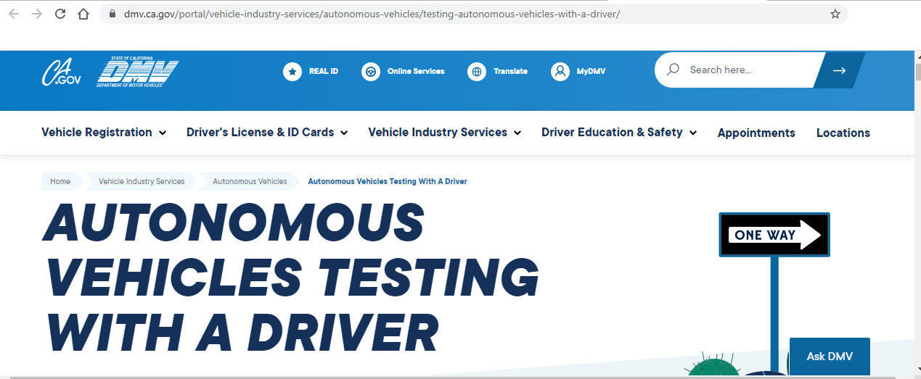
California
Testing of AVs is allowed (2014)
Nynke Vellinga, n.e.vellinga@rug.nl

Slide 4
California
Testing of AVs is allowed (2014): California Code of Regulations and California Vehicle Code
Permit from DMV
Requirements include:
With driver or with a certified remote operator (without driver)
Law enforcement interaction plan
Two-way communication link
ODD of test vehicle
California Vehicle Code: ‘Prior to the start of testing in this state, the manufacturer performing the testing shall obtain an instrument of insurance, surety bond, or proof of self-insurance in the amount of five million dollars ($5,000,000)’(..)’
Nynke Vellinga, n.e.vellinga@rug.nl

Slide 5
Sweden
Testing of AVs is allowed
Permit from Transportstyrelsen
Nynke Vellinga, n.e.vellinga@rug.nl

Slide 6
Sweden
Testing of AVs is allowed
Permit from Transportstyrelsen (Swedish Transport Agency) (Förordning (2017:309), TSFS 2021:4)
Requirements include:
Description of trial (incl. purpose, roads)
Ensuring traffic safety and no significant disturbance surroundings
Risk assessment
Responsibilities within company performing trial
Compliance with traffic law
Driver inside or outside of the vehicle (person activating system)
Nynke Vellinga, n.e.vellinga@rug.nl

Slide 7
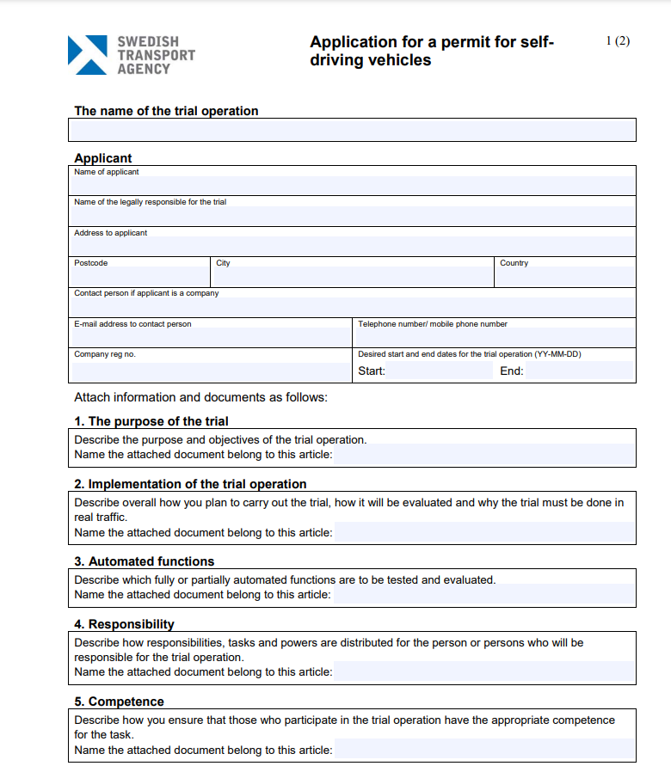
Sweden
Nynke Vellinga, n.e.vellinga@rug.nl

Slide 8
Netherlands
Testing of AVs is allowed
Permit from Ministry > RDW (art. 149aa Wegenverkeerswet 1994)
Nynke Vellinga, n.e.vellinga@rug.nl

Slide 9
Netherlands
Testing of AVs is allowed
Permit from Ministry > RDW (art. 149aa Wegenverkeerswet 1994)
Requirements include:
Description of trial (incl. roads and weather conditions)
Driver inside or outside of the vehicle
Indication of number of vehicles driven by one driver
Other terms and conditions permit
Deviation from existing traffic law can be allowed (e.g. ‘driver’)
Contribution to road safety, innovation
Nynke Vellinga, n.e.vellinga@rug.nl

Slide 10
Netherlands | Sweden | California (USA)
Driver: person who drives | Driver: person who activates system | Driver or remote operator
Deviation from traffic rules possible | In accordance with traffic rules | In accordance with traffic rules
Existing liability rules apply (owner 185 WVW 1994!) | Existing liability rules apply | Existing liability rules apply
Third party- insurance | First party-insurance | insurance, a surety bond, or proof of self-insurance
Nynke Vellinga, n.e.vellinga@rug.nl

Slide 11
California
Deployment of AVs is allowed
Permit from DMV
Requirements include:
With driver or a remote operator
Law enforcement interaction plan and a communication link
‘The manufacturer shall certify that the autonomous technology is designed to detect and respond to roadway situations in compliance with all provisions of the California Vehicle Code and local regulation applicable to the performance of the dynamic driving task in the vehicle's operational design domain, (…).’
insurance, a surety bond, or proof of self-insurance.
Nynke Vellinga, n.e.vellinga@rug.nl

Slide 12
California
Nynke Vellinga, n.e.vellinga@rug.nl

Slide 13
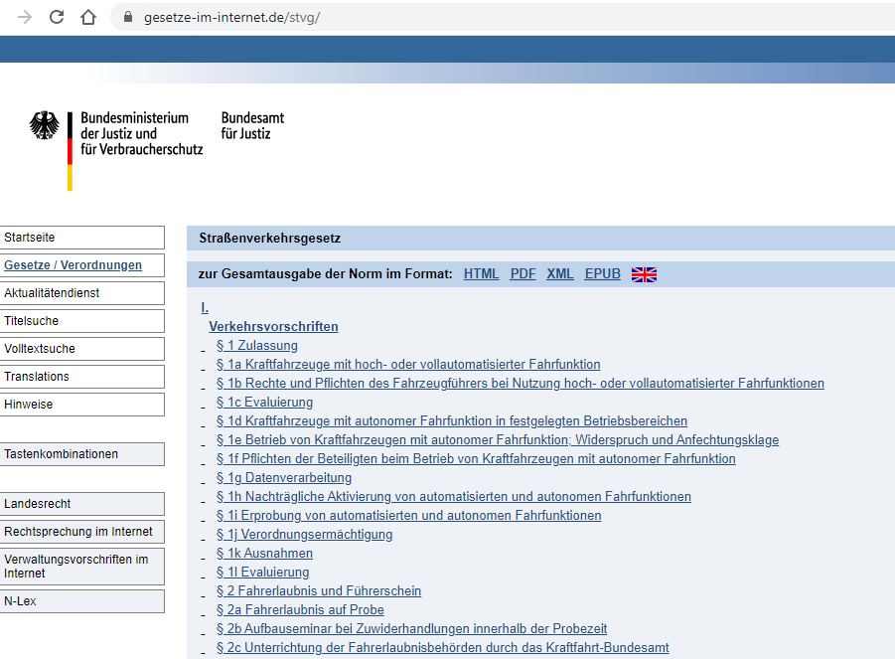
Germany
Nynke Vellinga, n.e.vellinga@rug.nl

Slide 14
Germany
Straßenverkehrsgesetz
SAE Level 3:
Driver is the person who (de)activates the system
Driver is allowed to undertake other activities, but he must be ready to take over the wheel (‚wahrnehmungsbereit‘)
Nynke Vellinga, n.e.vellinga@rug.nl

Slide 15
Germany
Straßenverkehrsgesetz
SAE Level 4:
Technische Aufsicht (technical supervision)
Minimal risk condition (or alarm Technische Aufsicht)
Betriebserlaubnis Kraftfahrt-Bundesamt
Keeper of vehicle is responsible for maintaining road safety, maintanance of the vehicle’s systems, take precutions to comply with traffic rules not directed at driver, and is responsible for fulfilling the tasks of the Technische Aufsicht
Nynke Vellinga, n.e.vellinga@rug.nl

Slide 16
Germany
Straßenverkehrsgesetz
SAE Level 4:
Technische Aufsicht
Minimal risk condition (or alarm Technische Aufsicht)
Betriebserlaubnis Kraftfahr-Bundesamt
Technische Aufsicht eines Kraftfahrzeugs mit autonomer Fahrfunktion im Sinne dieses Gesetzes ist diejenige natürliche Person, die dieses Kraftfahrzeug während des Betriebs gemäß § 1e Absatz 2 Nummer 8 deaktivieren und für dieses Kraftfahrzeug gemäß § 1e Absatz 2 Nummer 4 und Absatz 3 Fahrmanöver freigeben kann.
Nynke Vellinga, n.e.vellinga@rug.nl

Slide 17
United Kingdom
Law Commission and the Scottish Law Commission: Consultation Paper 3 – A regulatory framework for automated vehicles
user-in-charge
Inside or within sight of the vehicle
Duties not related to DDT
Fit and qualified to drive
Transition demand
non-user-in-charge
Remote operation
Licenced operator
“Tier 1” duties to supervise, maintain, insure, install updates, report incidents
“Tier 2” duties for certain use cases
Automated Driving System Entity (ADSE)
Nynke Vellinga, n.e.vellinga@rug.nl

Slide 18
United Kingdom
Already: Automated and Electrical Vehicles Act 2018 (AEVA 2018):
2(1) Where—
(a) an accident is caused by an automated vehicle when driving itself on a road or other public place in Great Britain,
(b) the vehicle is insured at the time of the accident, and
(c) an insured person or any other person suffers damage as a result of the accident,
the insurer is liable for that damage.
Nynke Vellinga, n.e.vellinga@rug.nl

Slide 19
Germany | California | English and Scottish Law Commissions
Technische Aufsicht (deactivate system, no continual monitoring) | Remote operator | User-in-charge or remote operator, plus ADSE
Minimal risk condition (back-up Technische Aufsicht) | Minimal risk condition | Minimal risk conditional, transition demand
Betriebserlaubnis Kraffahrtbundesamt | Permit DMV | Safety assurance scheme on top of ‘usual’ approval
Pflichtversicherungs-gesetz | insurance, a surety bond, or proof of self-insurance | AEVA 2018
Nynke Vellinga, n.e.vellinga@rug.nl

Slide 20
Absence of driver
Trial
California: remote operator
Sweden: driver outside of vehicle, (de)activation system
Netherlands: driver outside of vehicle
Deployment:
California: remote operator
UK: user-in-charge or remote operator
Germany: Technische Aufsicht
Nynke Vellinga, n.e.vellinga@rug.nl

Slide 21
Absence of driver
Trial
California: remote operator
Sweden: driver outside of vehicle, (de)activation system
Netherlands: driver outside of vehicle
Deployment:
California: remote operator
UK: user-in-charge
Germany: Technische Aufsicht
Conventions on Road Traffic of 1949 and of 1968:
‘“Driver” means any person who drives a motor vehicle (…)’
‘Every moving vehicle (…) shall have a driver.’
Nynke Vellinga, n.e.vellinga@rug.nl

Slide 22
Conventions on Road Traffic of 1949 and of 1968:
‘“Driver” means any person who drives a motor vehicle (…)’
‘Every moving vehicle (…) shall have a driver.’
Art. 34bis 1968 Convention on Road Traffic (proposal adopted):
“The requirement that every moving vehicle or combination of vehicles shall have a driver is deemed to be satisfied while the vehicle is using an automated driving system which complies with:
(a) domestic technical regulations, and any applicable international legal instrument(…) and
(b) domestic legislation governing operation.
The effect of this article is limited to the territory of the contracting party where the relevant domestic technical regulations and legislation governing operation apply."
Nynke Vellinga, n.e.vellinga@rug.nl

Slide 23
To be continued…
New convention on road traffic
Leading to new traffic rules
Recent developments on cybersecurity, software updates and automatic lane keeping system
Nynke Vellinga, n.e.vellinga@rug.nl

Slide 24
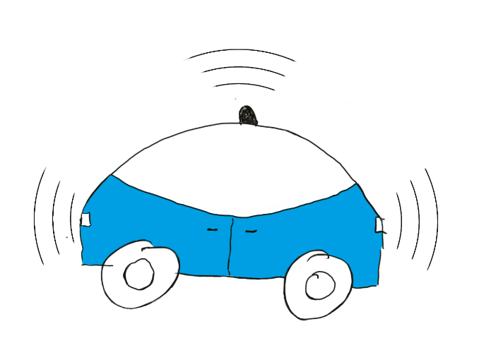
Thank you for your attention!
n.e.vellinga@rug.nl

